Slide 1
VIRTUAL INTERIOR DESIGN COMPANION-HARNESSING THE POWER OF GANs
Final Phase Presentation on Major Project of the AY: 2023-24
Presented By
Aditya Kumar 1NT20EC007
Yash Mathur 1NT20EC175
Shubham Sharma 1NT20EC178
Project Supervisor
Dr.Rekha Phadke
Associate Professor
Dept. of Electronics and Communication Engineering
Nitte Meenakshi Institute of Technology
Yelahanka, Bangalore-560064

Slide 2
Presentation Outline
Introduction
Literature Survey
Research Gap Analysis
Project Objectives
Design Methodology
Tools Required/Hardware/Software Specification
Dataset Description
Implementation Details
Results
Conclusion
References

Slide 3
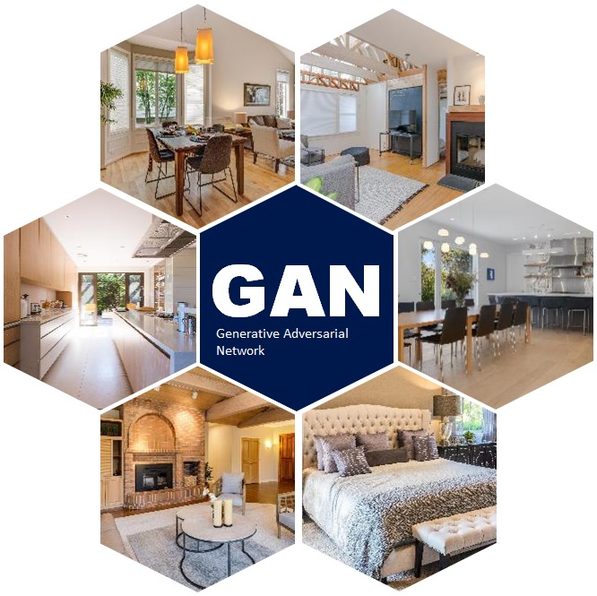
Introduction
Virtual interior designing using GAN (Generative Adversarial Networks) is a technique that allows designers to generate realistic and detailed images of interior spaces.
GANs are a type of machine learning algorithm that can learn the features and characteristics of a given dataset and generate new images that resemble the original data.
In the case of interior design, GANs can be trained on large datasets of interior images to learn the common features and patterns of interior spaces, such as furniture, lighting, and textures.

Slide 4
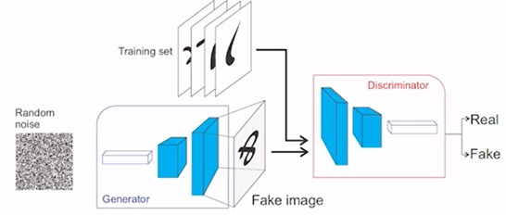
Introduction

Slide 5
Literature Survey
Ian J. Goodfellow, Jean Pouget-Abadie, Mehdi Mirza, Bing Xu, David Warde-Farley, Sherjil Ozair, Aaron C. Courville, and Yoshua Bengio. 2014. Generative Adversarial Networks. NIPS 27(2014)
The goal of a generative model is to learn the probability distribution that generated a collection of training examples.
GANs are successful in generating realistic high-resolution images.
GANs have been applied to a wide variety of tasks in research settings.
Most other approaches to generative modelling are based on optimisation.
Nirmalya Thakur and Chia Y Han. 2021. Multimodal Approaches for Indoor Localization for Ambient Assisted Living in Smart Homes.
The article discusses how AAL in Smart Homes is not limited to tracking indoor location.
AAL includes analysing user behaviour and activity patterns to improve their quality of life.
The article reviews the recent AAL technologies that improve user activity recognition and analysis in Smart Home.

Slide 6
Literature Survey
Tautkute et al., 2017, ACICS, IKEA: Interior Design Dataset
The dataset was collected from IKEA.com for building a non-commercial Style Search Engine.
The dataset includes 2193 product photos and 298 room scene photos.
The product photos show the objects, and the context photos show those objects in a room.
The ground truth information on which items appear in which rooms is also provided.
Lei Wang, Wei Chen, Wenjia Yang, Fangming Bi, and Fei Richard Yu. 2020. Review on Image Synthesis With Generative Adversarial Networks. IEEE Access 8(2020), 63514–63537
The paper reviewed basics of GANs and their applications in image synthesis.
The pros and cons of GANs applications were discussed.
Although research on GANs is becoming more mature, there is still room for improvement.
The paper summarized methods used in GANs applications to improve the performance of generated images.

Slide 7
Literature Survey
Hamed Alqahtani, Manolya Kavakli-Thorne, and Gulshan Kumar. 2019. Applications of generative adversarial networks (gans): An updated review. Archives of Computational Methods in Engineering (2019)
Comprehensive analysis of commonly used evaluation metrics for GAN performance
Mathematical explanation of metric definitions
Analysis of pros and cons of metrics in the context of GANs
Identification of the open problem of defining appropriate metrics for GAN evaluation
Emphasis on the importance of the choice of feature space in computing metrics
Recommendation for the creation of a code repository for evaluation metrics to enable comparative studies and benchmarking under consistent conditions
Suggestion to use multiple metrics for future studies and benchmarking

Slide 8
Literature Survey
Generative Design of Outdoor Green Spaces Based on Generative Adversarial Networks (Received: 23 February 2023 / Revised: 3 April 2023 / Accepted: 5 April 2023 / Published: 20 April 2023)
Early indoor design research focused on floor plans using pix2pix.
Challenges include complexity of outdoor green spaces and data limitations.
Research aims to explore complex outdoor space design with GANs and compare algorithm-driven and human designs.
OPTIMIZING LATENT SPACE DIRECTIONS FOR GAN-BASED LOCAL IMAGE EDITING Ehsan Pajouheshgar, Tong Zhang, and Sabine Susstrunk ¨ School of Computer and Communication Sciences, EPFL, Switzerland
Objective: To improve localized image editing using Generative Adversarial Networks (GANs) by addressing semantic attribute disentanglement.
Proposed Framework: Locally Effective Latent Space Direction (LELSD)
Editing Real Images: LELSD, when combined with GAN inversion models, enables sequential editing of real photos.
Performance Comparison: LELSD offers interactivity and efficient performance in comparison to other methods.

Slide 9
Research Gap Analysis
Better Understanding of Training Dynamics: GANs are known to be difficult to train, and there is still a lack of understanding of the underlying training dynamics. Further research is needed to improve the stability and convergence of GAN training.
Improved Sample Efficiency: GANs require a large amount of training data to generate high-quality output. Further research is needed to improve sample efficiency and reduce the amount of data required for training.
Explainability and Interpretability: GANs are often considered as black boxes, and it is difficult to understand how they generate synthetic data. Further research is needed to improve the interpretability of GANs and make them more explainable.
Robustness and Security: GANs are vulnerable to adversarial attacks and other forms of manipulation. Further research is needed to improve the robustness and security of GANs.

Slide 10
Project Objectives
The following are the proposed objectives of the project based on the research gaps:
A demonstration of how GAN’s can be used in the field of interior design and how it can improve the design process.
To evaluate the GAN architecture performance on the interior design based on the performance and error metrics.
Working with GAN might help interior designers gain the exposure they need. As a result, people benefit from technology and expand their knowledge base.

Slide 11
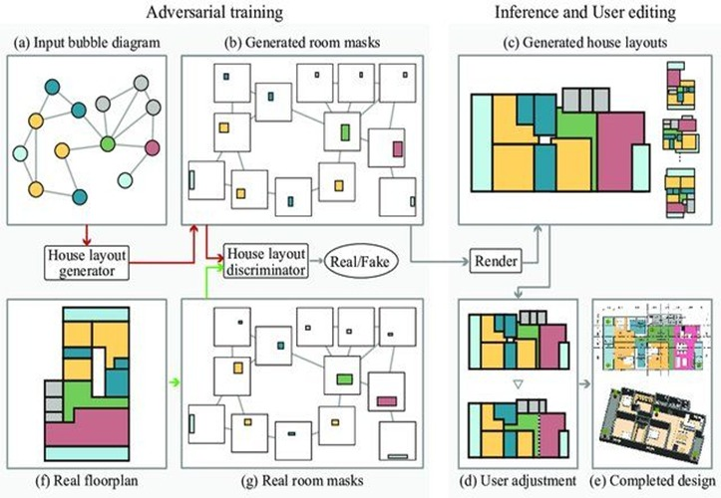
Design Methodology
The proposed approach for generating new interior designs using GANs involve the following stages :
•Data preprocessing and cleaning
Data cleaning report
Pre-processed dataset
•Building the GAN architecture
GAN architecture design document
GAN code implementation
•Training the GAN model
Trained GAN model weights
Training loss plot
•Evaluating the GAN model
Evaluation metrics report
Sample generated images.
•Generating new interior designs
Final generated interior designs

Slide 12
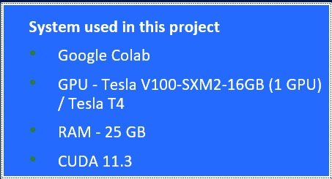
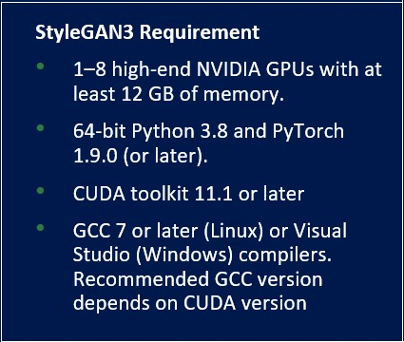
Tools Required/Hardware/Software Specification
Predefined StyleGAN3 Model by NVIDIA (https://github.com/NVlabs/stylegan3.git)
Setting up and training with styleGAN3 is very challenging.
Requires a very high system and GPU processor
High training epochs/ticks are required to achieve better results
StyleGAN3 Requirement

Slide 13
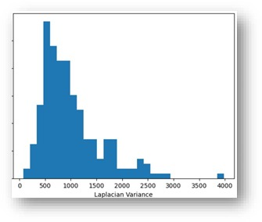
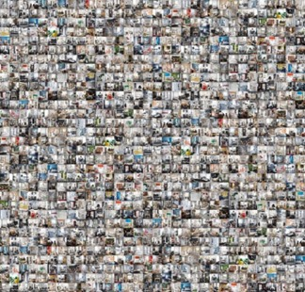
Dataset Description
Dataset Details: 2,193 object photos and 298 room scene photos with text descriptions and ground truth information.
Image Specs: RGB images with varying sizes and aspect ratios, uncategorized.
Focus Quality: Variance of Laplacian shows some images are out of focus and treated as outliers.
Ground Truth: Detailed information on items appearing in room scenes is provided.

Slide 14
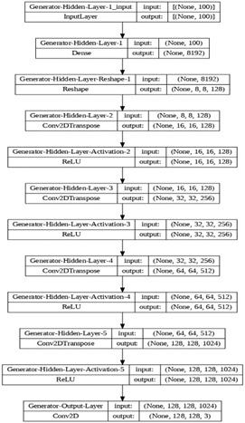
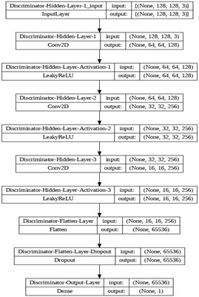
Implementation details
A. The DCGAN-based interior design model
Convolutional Replacements: Pooling layers are replaced by stride convolutions in the discriminator and fractional-stride convolutions in the generator.
Batch Normalization: Both the discriminator and generator use batch normalization.
Activation Functions: The generator uses RELU in all layers except the output, which uses tanh, while the discriminator uses Leaky RELU in all layers except the output, which uses Sigmoid.
Trainable Parameters: The generator has 12,178,307 trainable parameters, and the discriminator has 1,645,185 trainable parameters.

Slide 15
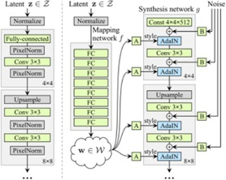
Implementation details
B. StyleGAN3 Based Interior Design Model
Mapping and Styles: Latent code \( z \) is transformed into \( w \) using a mapping network, with AdaIN replacing PixelNorm for styling.
Constant and Noise Inputs: A constant vector replaces the latent code input in the synthesis network, and explicit noise inputs with learned scaling factors add stochastic details to feature maps.
Style Mixing: Mixing regularization combines styles from two latent codes during training, integrating a progressive growth mechanism to address traditional GAN limitations.

Slide 16
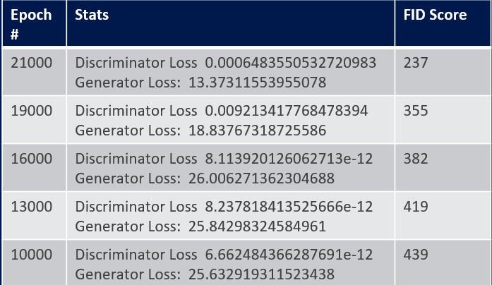
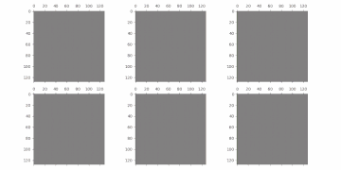
DC GAN Results
21800 epochs
Problem with model collapse & vanishing gradient

Slide 17
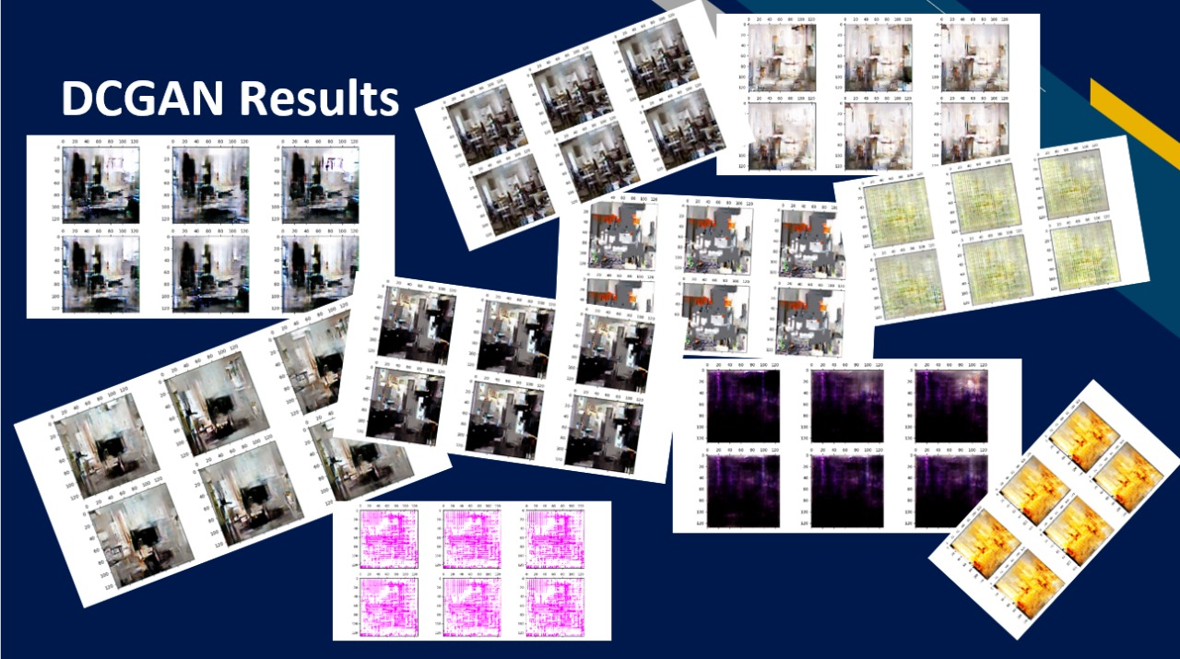
DC GAN Results

Slide 18
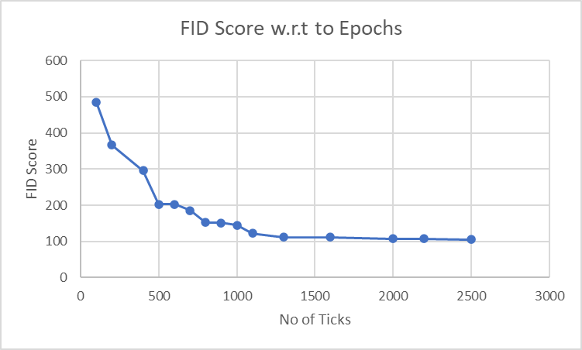
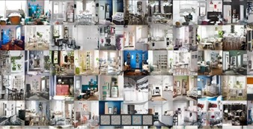
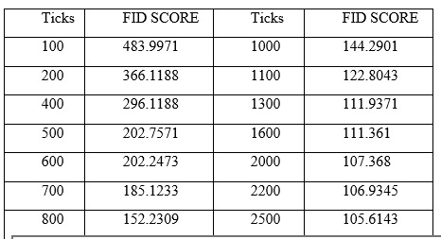
StyleGAN3 Results
Training Epochs: The StyleGAN3 generator required around 2500 epochs to produce high-quality images, though images remained somewhat blurry and needed more training for optimal results.
Performance Metrics: Performance metrics for StyleGAN3 are provided in table and figure.
Image Quality: Good quality images can be observed after 2500 epochs, as shown in figure.

Slide 19
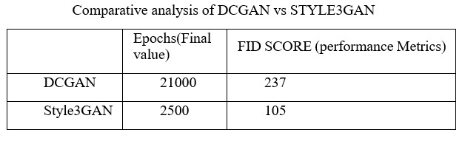
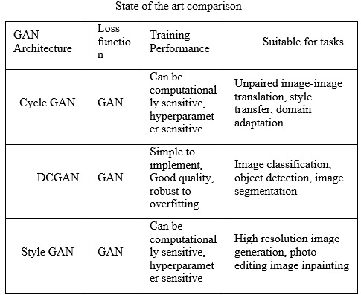
Conclusion
Performance Comparison: Table 4 shows that DCGANs have higher loss values and FID scores across epochs, focusing on training progress and balance between generator and discriminator, whereas StyleGAN focuses more on overall image quality with frequent FID score monitoring.
State-of-the-Art GANs: Table 5 compares GAN architectures suitable for various tasks like image classification, object detection, high-resolution image generation, image analysis, and natural language processing.
Challenges and Future Work: Challenges include system limitations, vanishing gradients, mode collapse, lack of pre-trained models, uncategorized datasets, and limited data. Overcoming these can extend the model for interior design generation, with improvements through hyperparameter tuning, more training, and exploring other GAN models for features like design from sketches and text-to-design transformations.

Slide 20
References
Ian J. Goodfellow, Jean Pouget-Abadie, Mehdi Mirza, Bing Xu, David Warde-Farley, Sherjil Ozair, Aaron C. Courville, and Yoshua Bengio. 2014. Generative Adversarial Networks. NIPS 27(2014)
Nirmalya Thakur and Chia Y Han. 2021. Multimodal Approaches for Indoor Localization for Ambient Assisted Living in Smart Homes. Information 12, 3 (2021), 114.
Tautkute et al., 2017, ACICS, IKEA: Interior Design Dataset.
Lei Wang, Wei Chen, Wenjia Yang, Fangming Bi, and Fei Richard Yu. 2020. Review on Image Synthesis With Generative Adversarial Networks. IEEE Access 8(2020), 63514–63537
Hamed Alqahtani, Manolya Kavakli-Thorne, and Gulshan Kumar. 2019. Applications of generative adversarial networks (gans): An updated review. Archives of Computational Methods in Engineering (2019)
Generative Design of Outdoor Green Spaces Based on Generative Adversarial Networks
Optimizing latent pace directions for gan-based local image editing

Slide 21
THANK YOU

